Slide 1

T99X171.00 comparison table of different FW CPU Loading
Cooper.Kung
2022.12.26

Slide 2
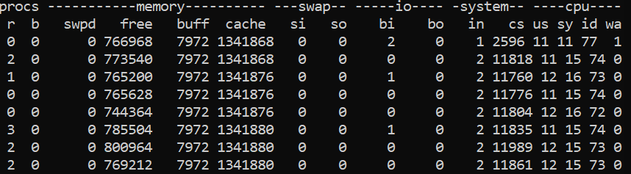
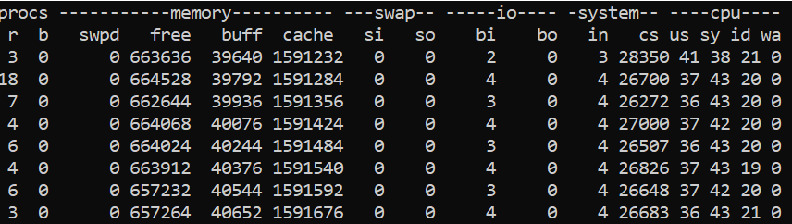
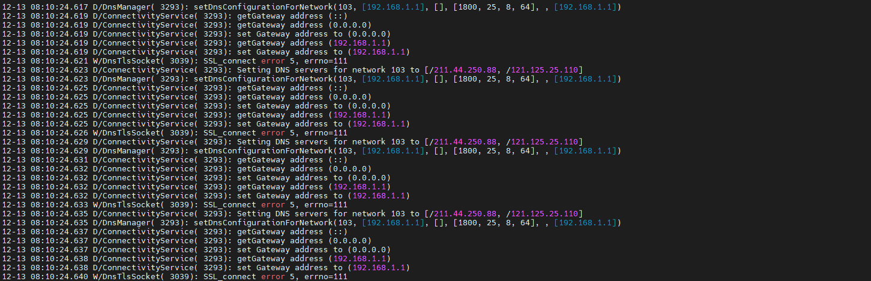
T99X171.00 comparison table of different FW CPU Loading(Test condition: 4K Video on local + iperf 50Mbps)
1.FW Version: 15.502.13(r13 DVT1) | 1.FW Version: 15.523.06(Remove Shield CAN)
2.Command: vmstat | 2.Command: vmstat
3.CPU Load = 100-id=80% | 3.CPU Load = 100-id=27%
4.Cause of high CPU loading: logcat will continue output error message, It will cause high load on system server
5. Summary: 15.502.13(r13 DVT) FW will logcat output error message continuously when Ethernet connected. It will also causes high CPU load and leads to poor thermal test results.

Slide 3


Slide 4
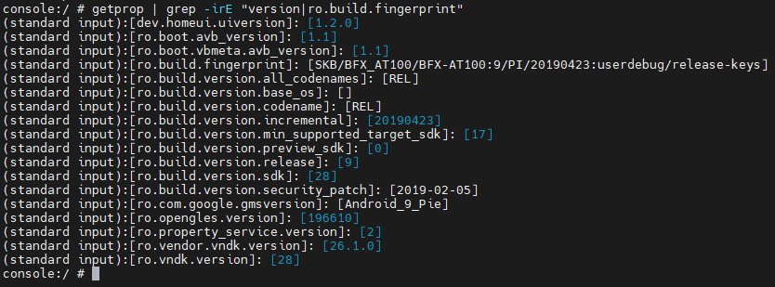
ALT Test result
TestFW : r13 dvt1 (15.502.13) image link ,
https://drive.google.com/file/d/1RVL-z53myPbXWknuy9KDweLcFAWfF_i8/view?usp=share_link

Slide 5
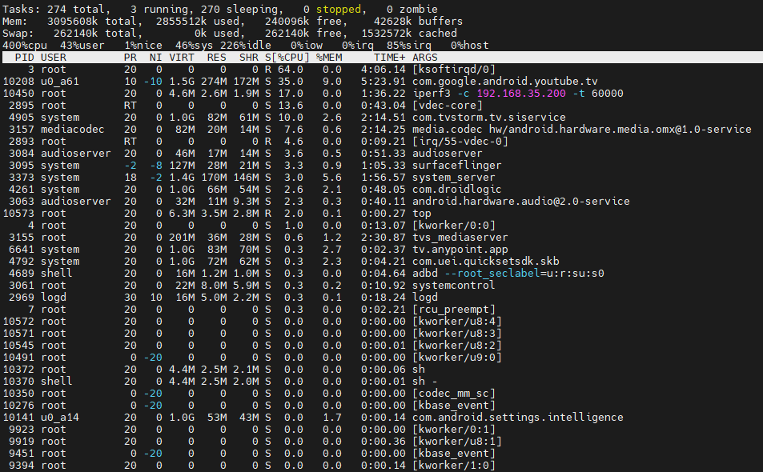
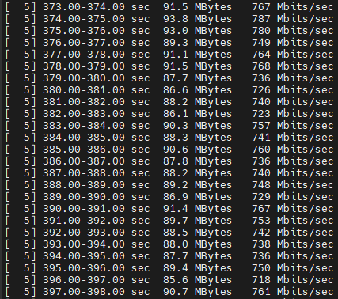
ALT Test result
Running Youtube(4K) and iperf3 at the same time

Slide 6
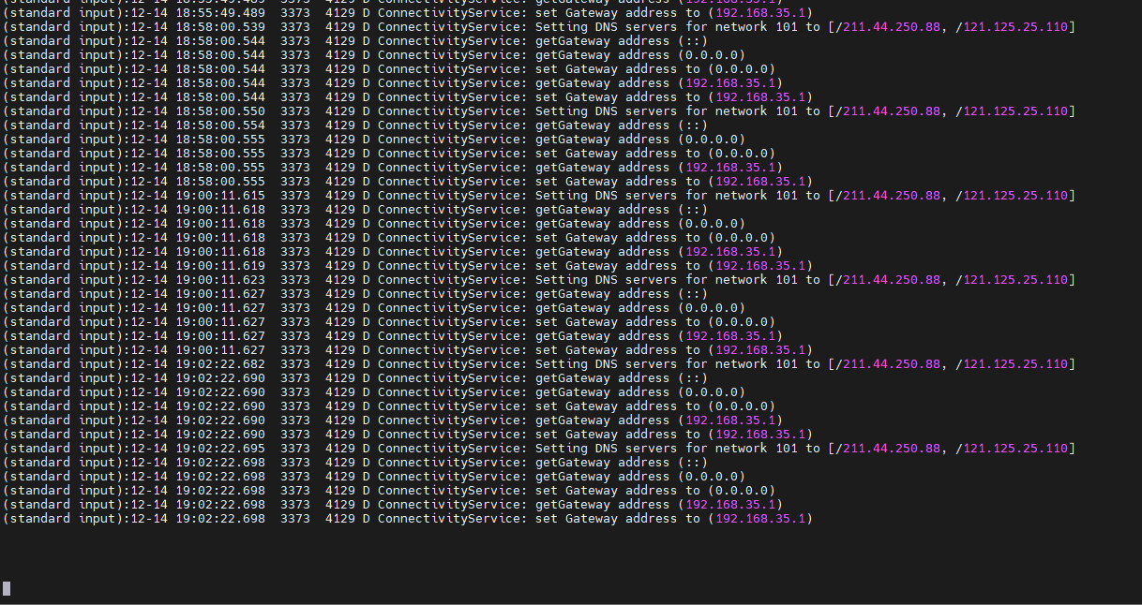

ALT Test result
The connectivity log is observed every 2 minutes and 11 seconds

Slide 7
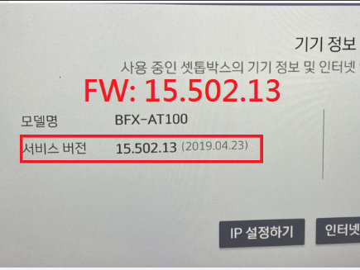
Re-test by Foxconn(15.502.13)
TestFW : r13 dvt1 (15.502.13) image link ,
https://drive.google.com/file/d/1RVL-z53myPbXWknuy9KDweLcFAWfF_i8/view?usp=share_link

Slide 8
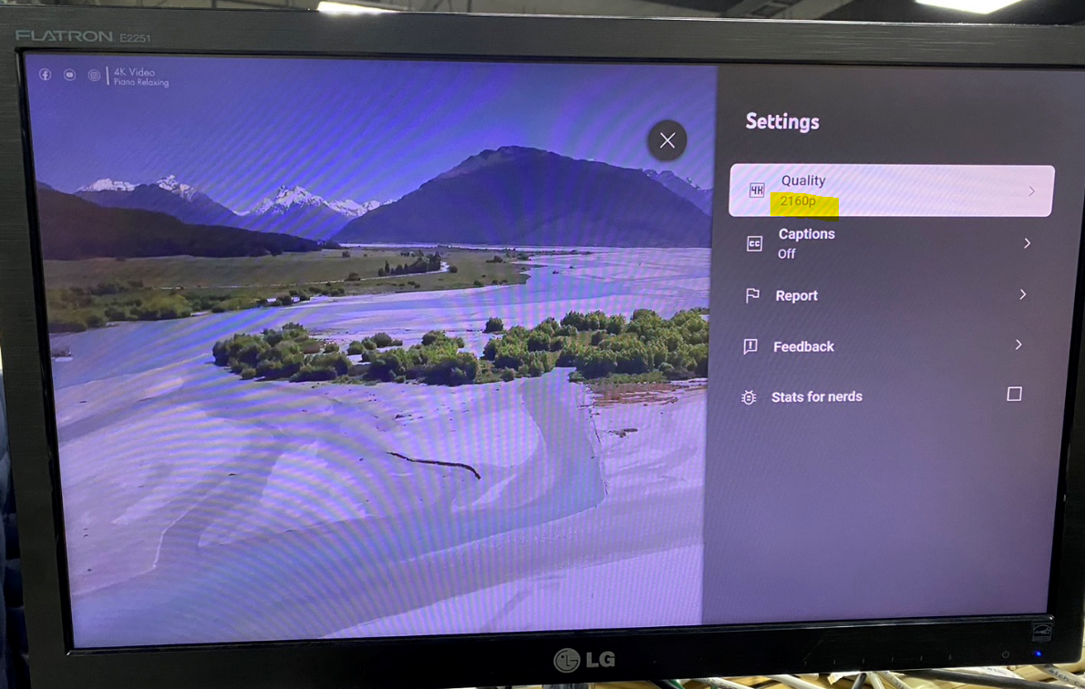
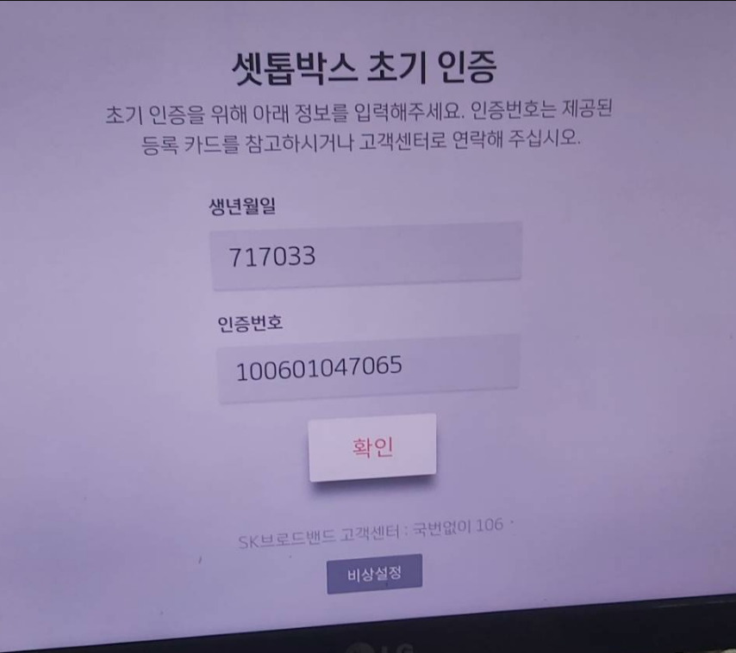
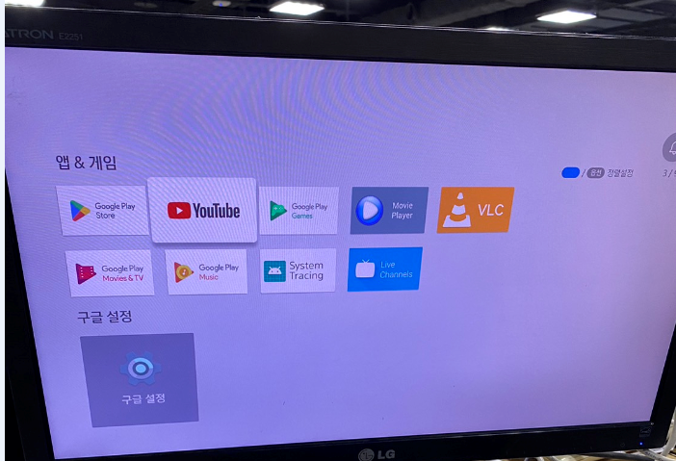
Re-test by Foxconn(15.502.13)
Success log in

Slide 9
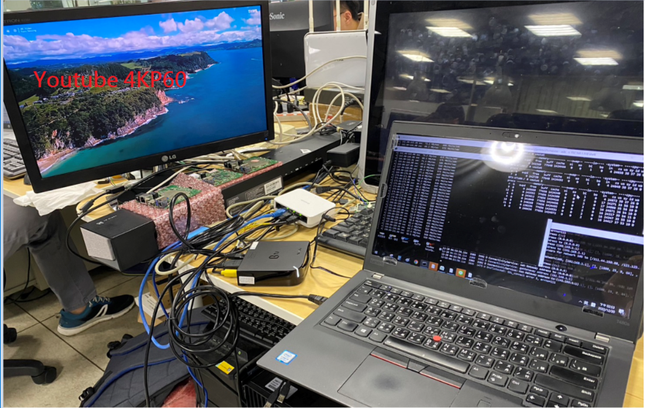
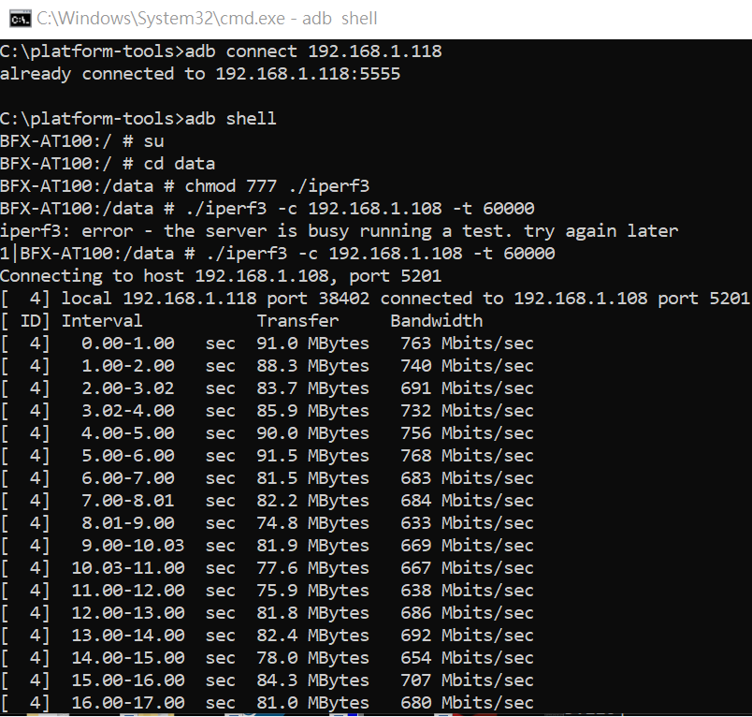
Re-test by Foxconn(15.502.13)
Running Youtube(4K) and iperf3 at the same time

Slide 10
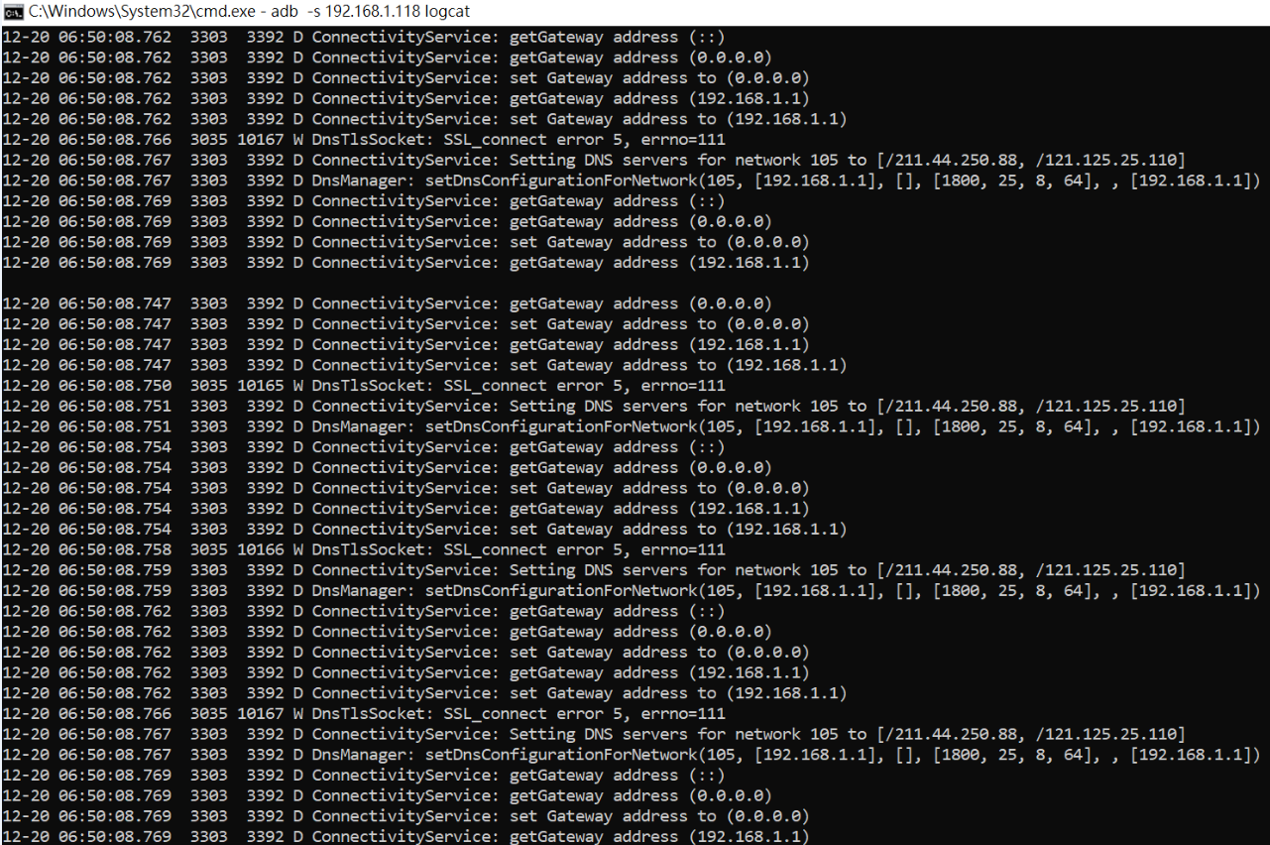
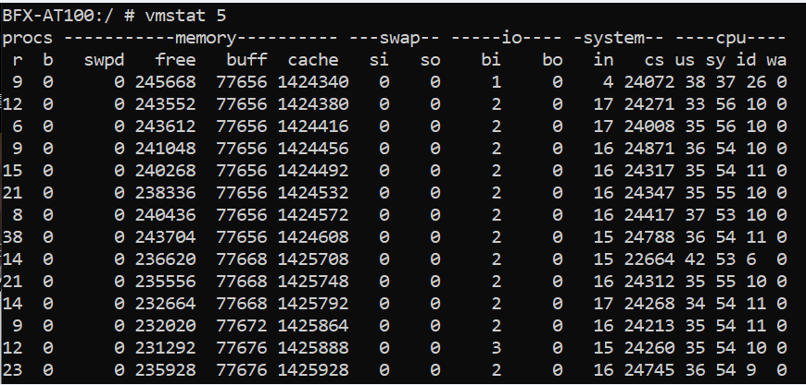
Re-test by Foxconn(15.502.13)
logcat will continue output error message, It will cause high load on system server(CPU Loading~90%)

Slide 11
Re-test by Foxconn(15.502.43)

Slide 12
Re-test by Foxconn(15.502.43)
Running Youtube(4K) and iperf3 at the same time

Slide 13
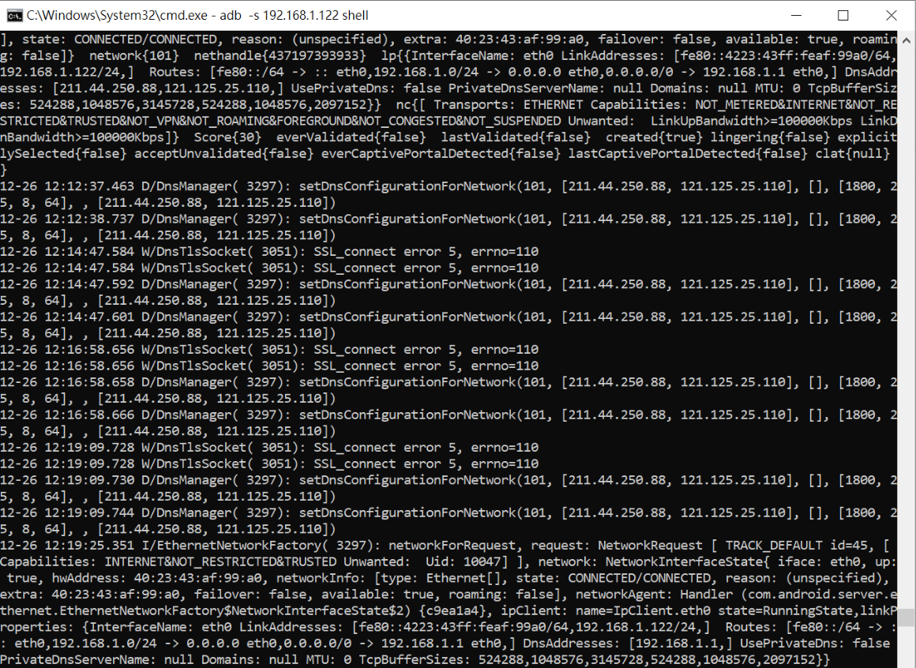
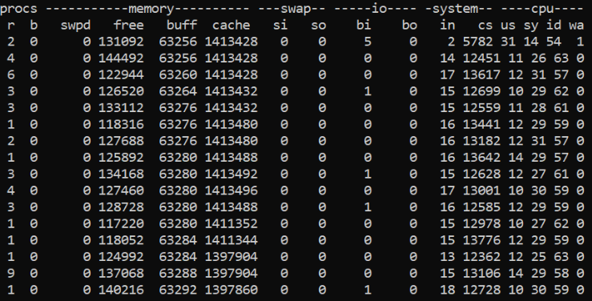
Re-test by Foxconn(15.502.43)
logcat is normal and system loading is stable also(CPU Loading~40%)

Slide 14
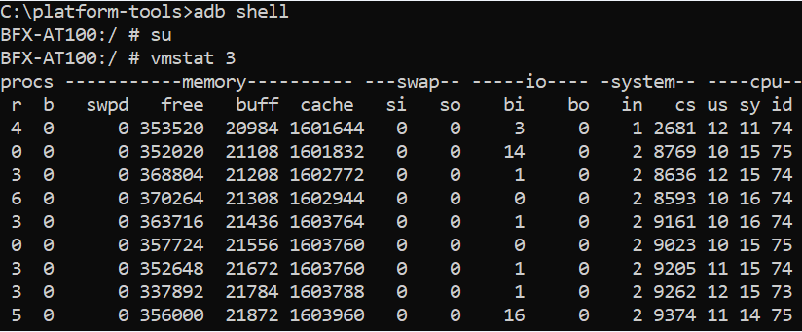
Re-test by Foxconn(15.502.43)
No log in
Iperf 50Mbps
4K Video on local
logcat is normal and system loading is stable also(CPU Loading~25%)

